Slide 1
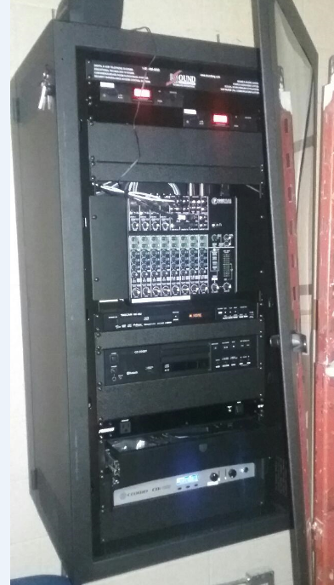
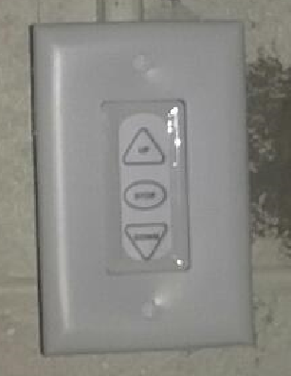
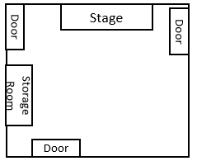
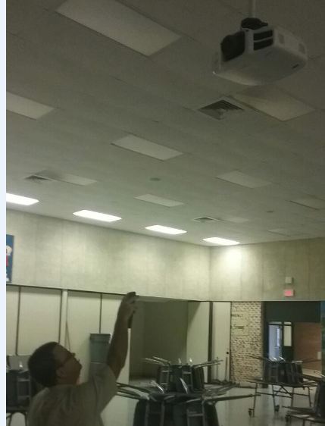
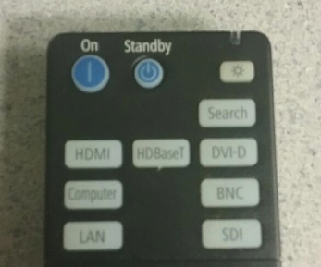
East Cafeteria Projector
Set-up, Page 1
To lower the projector screen into place.
If you are standing in front of the stage:
Go to the left side of the stage and push the down arrow button on the control box. (It will automatically lower to the correct position.)
To turn on the Projector.
Get the remote out of the sound system cabinet in the storage room.
Aim the remote at the projector and push the “On” button.

Slide 2
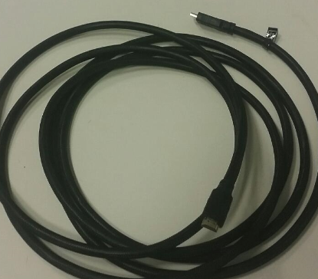
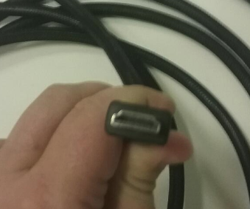
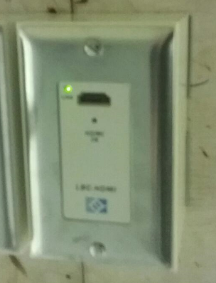
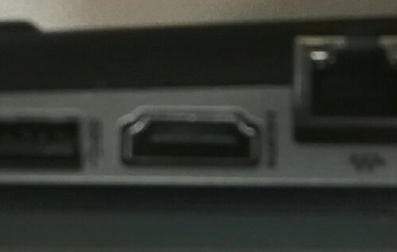
East Cafeteria Projector
Set-up, Page 2
Connect a laptop to the projector.
Get the HDMI cable out of the sound system cabinet in the storage room.
Plug in one end of the HDMI cable to the connection on the stage.
It is centered on the bottom side of the stages overhang, when you are standing looking at the stage.
Plug in the other end of the HDMI cable to the HDMI port on the laptop.
If your mobile device does not have a HDMI port, please contact the Help Desk (244-1215) to create a ticket and a technician will assist you with the appropriate adapter.

Slide 3
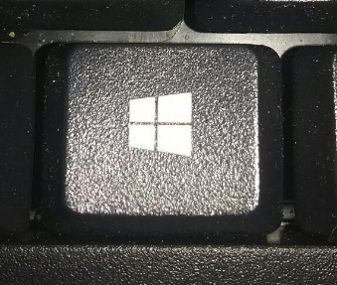
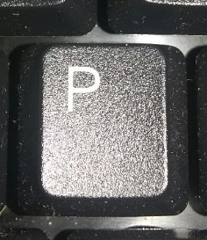
East Cafeteria Projector
Set-up, Page 3
Confirm that the laptop's settings for “project to a connected screen” is in duplicate mode.
This can be done by pressing the Windows key and “P.”
(This is for Windows 7, 8.1, & 10)
If you have an operating system other than Windows 7, 8.1, & 10 Contact the Help Desk (244-1215), to create ticket and a technician can assist in setting “project to a connected screen” for your operating system.
Confirm that everything is working (sounds and display).
If you have any questions, please contact the Help Desk (244-1215), to create a ticket and a technician will assist you.

Slide 4
East Cafeteria Projector
Tear Down, Page 1
To turn off the Projector.
Aim the remote at the projector and push the “Standby” button.
Disconnect a laptop from the projector.
Un-Plug the HDMI cable from the connection on the stage.
It is centered on the bottom side of the stages overhang, when you are standing looking at the stage.
Un-Plug the other end of the HDMI cable to the HDMI port on the laptop.

Slide 5
East Cafeteria Projector
Tear Down, Page 2
To raise the projector screen.
If you are standing in front of the stage:
Go to the left side of the stage and push the up arrow button on the control box. (it will automatically raise to the correct position.)
Return the following back to the Sound System Cabinet in the storage room.
Remote Control
HDMI Cable

