Slide 1
Adding and Subtracting Integers and Unit Rate Prices
By:Erica and Lewis

Slide 2
Unit Rate Price
Cross Multiply & Divide
1.you have to solve with the money they give you.
2.what is the price ?
3. you have to cross multiply with the price it is going to always be one because you wanna know how much 1 cost.
4.The first answer you get you are going to divide by the number that you have not used.
$10.00 X
5 1
$10.00 x 1 = $10.00
$10.00 5 = 2
x = 2

Slide 3
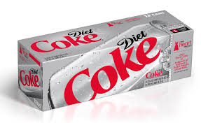
Unit Rate Price
Mrs. Jenkins is going to the store to get 3 packs
of Diet Coca Cola for $10.00.
$ 10.00 X
3 packs 1
Cross Multiply and Divide
$10.00 x 1 = $10.00 3 = $3.33 each pack
X = $3.33 each pack

Slide 4
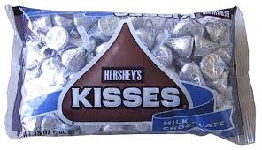
unit rate Price
Mrs.Batten has to buy 2 bags of hershey kisses candy for $6.00.
$6.00 X
2 1
$6.00 x 1=$6.00 2 = 3
X = 3 each bag

Slide 5
Adding and Subtracting Integers
Adding Integers you have to do a T chart.Then who wins?
by how many?
Subtracting Integers you have to do Keep,Change,Change.Then T chart

Slide 6
Adding Integers
(-10)+5= -5
who wins? -10
by how many? 5
If they are on the same side
If they are on different side
5 -10

Slide 7
Subtracting Integers
K C C
12-(-21)=
12+(+21)= 12
21
Keep,Change,Change + 33
then you do T chart

Slide 8
Subtracting Integers
You have to do Keep,Change,Change than T chart
K C C
50-(-30)= 50+30=80
50
30

Slide 9
References
http://www.ruralking.com/domestics/consumables/pop-and-soda/diet-coca-cola-12-pack-coke-diet-12-p.html (coca cola picture)
http://www.christmaspartygameideas.com/2011/christmas-party-game-hershey-kisses/(hershays kisses)

