Slide 1
Solving for X & Pythagorean theorem
By Salome Solorzano
March 24, 2015

Slide 2
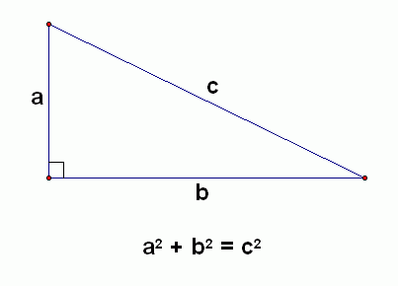
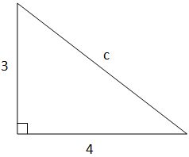
Pythagorean Theorem
solving for A & B =legs
solving for C = hypotenuse

Slide 3
Pythagorean Theorem
write problem out
times the 22 by the same number (22) = 484
do the same thing with the 23 = 529
with the 484 subtract it from the same number (484) at equals 0 so you just cross it out
the +b² comes down
then with the 529 subtract it by 484
what you do to one side you do the the other side
it equals to 6.7 so that the anwer
a²+b²=c²
22²+b²=23²
22x22
23x23
484 +b²
-484
= 529
-484
23
b
b²= 45
b=6.7
22

Slide 4
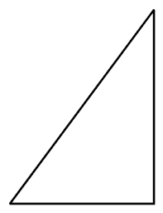
Pythagorean Theorem
a²+b²=c²
10²+30²=c²
write the promblem out
time the 10 by the same number (10)
equal 100
do the same with 30 times it by the same number (30)
equal 900
add the 100 and 900
equal 1000
square root the 1000
equal 31.62
31.62 equals C
10x10
30x30
10
100
900
30
1000 = c²
31.62=C

Slide 5
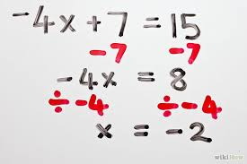
Solving for X
important information
changing positives (+) to negatives (-)
rounding
bring down
finding x
what you do to one side you do to the other

Slide 6
solving for x
write problem out
change the postive 20 to a negative -20
because it would be the opitcat
+20 and -20 equal 0 so cross it out
what you do to one side you do to the other
with the 30 subtract by 20 equal 10
bring down the 14x
divide the 14 by the same number 14
because we have to get x by it self
what you do to one side you do the the other side
divide 14 with the 10 equal 0.7
0.7 is equal to x
14x+20= 30
-20 -20
14x = 10
14 14
x= 0.7

Slide 7
solving for x
Write problem out
Change the nagitive to a positive
What you do to one side you do to the other
Add -17 and +17
It equal to 0 cross it out
Now with the 25 add it by 17
Bring down the 12
Get x by it self
Divided the 12 by the same number (12)
What you do to one side you do the the other side
Divided 42 by 12
Equal 3.5
3.5 is x
12x -17= 25
+17. +17
12x 42
➗12 ➗12
X = 3.5

Slide 8
references
http://etc.usf.edu/clipart/41400/41477/rt_tri_55-35_41477.htm (right triangle)
http://ncalculators.com/number-conversion/pythagoras-theorem.htm (a²+b²+c²)
http://www.1728.org/pytproof.htm
(solving for C = hypotenuse)
http://www.wikihow.com/Solve-Two-Step-Algebraic-Equations (solving for x)

